Slide 1


Mehmet Kadri Is
25/04/2024

Slide 2

Outline
Executive Summary
Introduction
Methodology
Results
Conclusion
Appendix

Slide 3
Executive Summary
Data has been collected from public SpaceX API. Explored data using SQL, visualization, folium maps and dashboards.
Machine Learning Models Created: Logistic Regression, Support Vector Machine, Decision Tree Classifier and K Nearest Neighbors.Similar result have been produced with accuracy rate about 83.33 percent.All models over predicted successful landing.

Slide 4
Introduction
SpaceX’s commitment to reusable rockets has significantly mitigated space travel costs by strategically focusing on the retrieval of the first rocket phase. The recovery of this initial phase is paramount in preserving and reusing expensive components, contributing directly to cost reduction. An in-depth analysis of the success rate of these retrieval events serves as a valuable metric for evaluating efficiency and cost-effectiveness in SpaceX’s pioneering approach. This particular project is geared towards predicting the success of the first phase retrieval event, thereby offering predictive insights aimed at enhancing decision-making within the space industry.
Our objective is to forecast the success of first-phase rocket retrieval, with the overarching aim of optimizing resource allocation. By achieving this predictive capability, we seek to enhance mission success rates and contribute to substantial cost savings.

Slide 5

Section 1

Slide 6
Methodology
Executive Summary
Data collection methodology:
Collected from SpaceX public API and SpaceX Wikipedia site
Perform data wrangling
Landings classified as successful and unsuccessful otherwise
Perform exploratory data analysis (EDA) using visualization and SQL
Perform interactive visual analytics using Folium and Plotly Dash
Perform predictive analysis using classification models

Slide 7
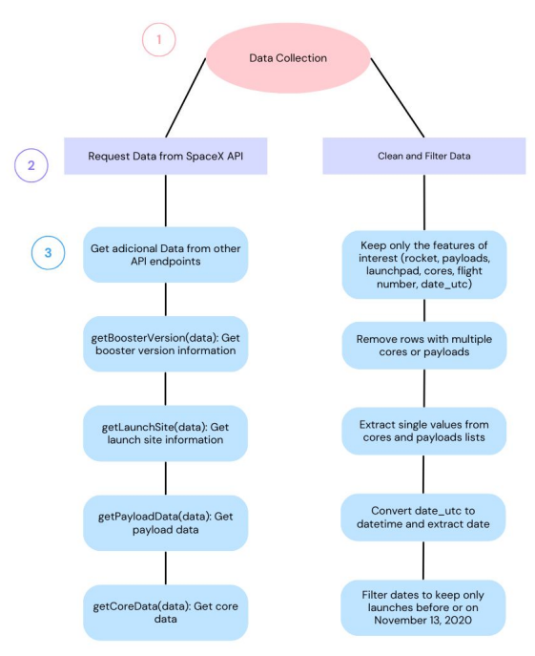
Data Collection – SpaceX API
Request Data.
Get additional Data from other API endpoint.
Filter Data
Clean Data
Create DataFrame
Data Collection Notebook:
https://github.com/mehmetkadri1/IBM-Data-Scientist-Capstone-/blob/896ed6e523d7656bf9b5a3409b65c3d99599f806/Week1-Data%20Scienctist%20Capstone/DataCollectionAPI.ipynb

Slide 8
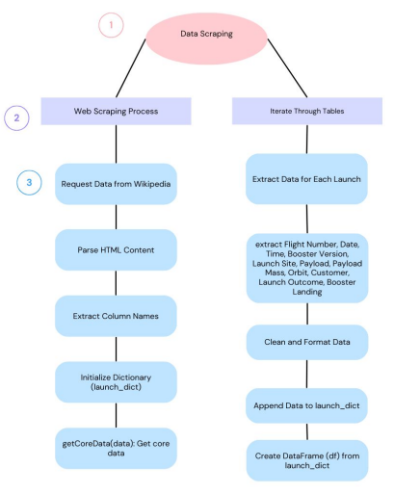
Data Collection - Scraping
Request Data: Retrieving the HTML content of the Wikipedia page.
Parse HTML: Using BeautifulSoup to parse and extract tables
Clean and Format Data:Utilizing functions for data cleaning
https://github.com/mehmetkadri1/IBM-Data-Scientist-Capstone-/blob/896ed6e523d7656bf9b5a3409b65c3d99599f806/Week1-Data%20Scienctist%20Capstone/DataCollectionWebScraping.ipynb

Slide 9
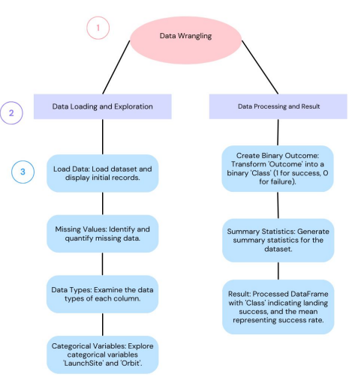
Data Wrangling
Loaded the dataset from a CSV file.
Checked for missing values for each column.
Checked the data types of each column.
Generated summary statistics of the DataFrame.
Data Wrangling Notebook: https://github.com/mehmetkadri1/IBM-Data-Scientist-Capstone-/blob/896ed6e523d7656bf9b5a3409b65c3d99599f806/Week1-Data%20Scienctist%20Capstone/DataWrangling.ipynb

Slide 10
EDA with Data Visualization
Chart Plotted and Reason:
FlightNumber vs. PayloadMass: Shows how flight number and payload mass relate to landing success, indicating heavier payloads my lead to less successful landing.
FlightNumber vs. LaunchSite: Identifies any patterns between launch site and mission success.
PayloadMass vs. LaunchSite: Illustrates the relationship between payload mass and launch site.
FlightNumber vs. Orbit Type: Reveals any patterns between flight number and orbit type.
https://github.com/mehmetkadri1/IBM-Data-Scientist-Capstone-/blob/896ed6e523d7656bf9b5a3409b65c3d99599f806/Week2-Data%20Scienctist%20Capstone/EDAVisualization.ipynb

Slide 11
EDA with SQL
Summary of SQL queries :
Unique launch sites
Records with launch sites starting with 'CCA'
Total payload mass by NASA (CRS) boosters
Data of first successful ground pad landing
Boosters with drone ship success and payload between 4000 and 6000
Count of landing outcomes between 2010-06-04 and 2017-03-20, ranked
https://github.com/mehmetkadri1/IBM-Data-Scientist-Capstone-/blob/896ed6e523d7656bf9b5a3409b65c3d99599f806/Week2-Data%20Scienctist%20Capstone/EDASQL.ipynb

Slide 12
Build an Interactive Map with Folium
Summary of map objects
Added Circle objects around launch sites with popups showing site names.
Used Marker objects with custom icons and popups for each launch site.
Employed MarkerCluster for nearby site grouping.
Integrated MousePosition for real-time latitude and longitude info.
Calculated and visualized distances to the nearest coastline.
Interactive Map with Folium Notebook
https://github.com/mehmetkadri1/IBM-Data-Scientist-Capstone-/blob/896ed6e523d7656bf9b5a3409b65c3d99599f806/Week3-Data%20Scienctist%20Capstone/InteractiveVisualsAnalytics.ipynb

Slide 13
Build a Dashboard with Plotly Dash
Success Pie Chart:
Summary and Interactions:This pie chart shows the total successful launches count for all sites or for a specific site if selected.Users can select a launch site from the dropdown list to view the success vs. Failure counts for that site.
Purpose:Provides an overview of the success rates at different launch sites, helping stakeholders understand the performance of each site.
Success vs. Payload Scatter Chart:
Purpose: Helps understand how payload mass affects launch success, allowing analysis based on specific criteria like launch site and payload range.
URL: https://github.com/mehmetkadri1/IBM-Data-Scientist-Capstone-/blob/896ed6e523d7656bf9b5a3409b65c3d99599f806/Week3-Data%20Scienctist%20Capstone/DV0101EN-Final_Assign_Part_2_Questions.py

Slide 14
Predictive Analysis (Classification)
Data Preparation: Created NumPy arrays from the data and standardized them.
Splitting Data: Split the data into training and test sets.
Model building.
Used GridSearchCV to find the best parameters for each algorithm.
Trained the models on the training data.
Model Evaluation: Calculated the accuracy of each model on the test data.
Model Comparison: Compared the accuracy of the models to find the best performer.
Based on the results, the Decision Tree model had the highest accuracy of 0.8889, making it the best performing model for this classification task.
URL: https://github.com/mehmetkadri1/IBM-Data-Scientist-Capstone-/blob/0ffc5d9b91a55fcb169e697c1721f9af4a4875db/Week4%20-%20Data%20Scientist%20Capstone/SpaceX_Machine_Learning_Prediction_Part_5.jupyterlite.ipynb

Slide 15
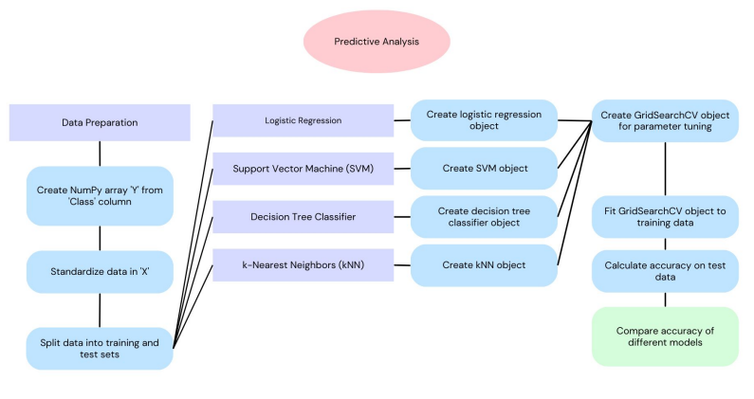

Slide 16
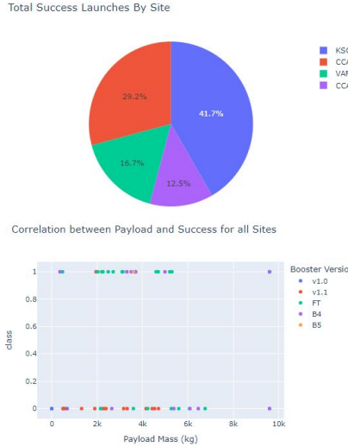
Results
Exploratory data analysis results:
Overall, these EDA results provide valuable insights into the dataset, which can be used to further analyze and model the data for predicting launch success.
Predictive analysis results:
The predictive analysis results indicate that the decision tree model had highest accuracy of 0.8889, making it the best performing model for the classification task. The other models, including Logistic Regression, Support Vector Machine and K-Nearest Neighbors, also performed well with accuracies of 0.8333.These result suggest that the Decision Tree model is the most suitable for predicting the outcome of spaceX launches based on the given dataset.

Slide 17

Section 2

Slide 18
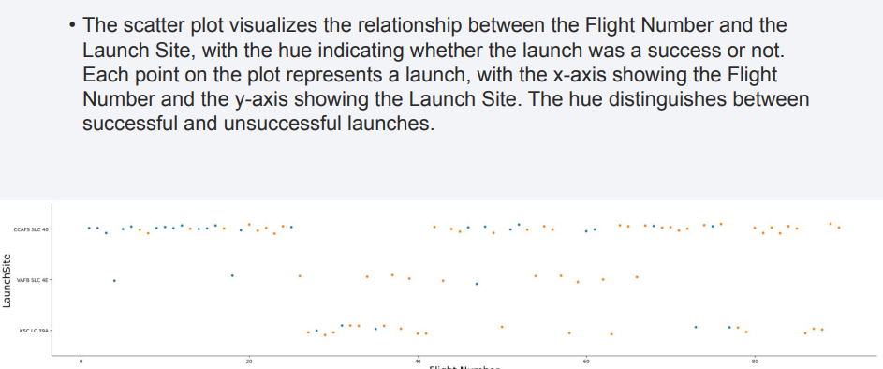
Flight Number vs. Launch Site

Slide 19
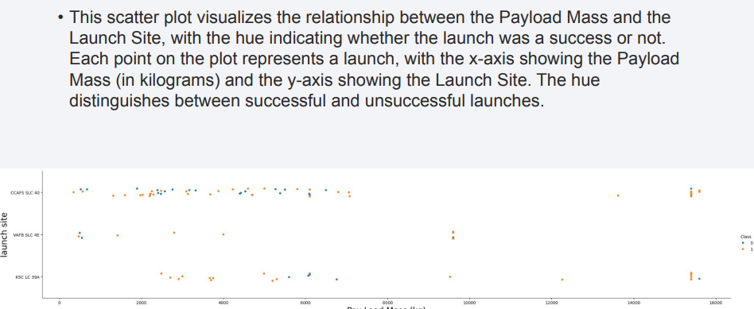
Payload vs. Launch Site

Slide 20
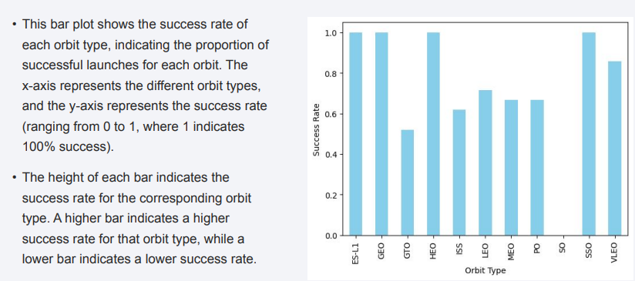
Success Rate vs. Orbit Type

Slide 21
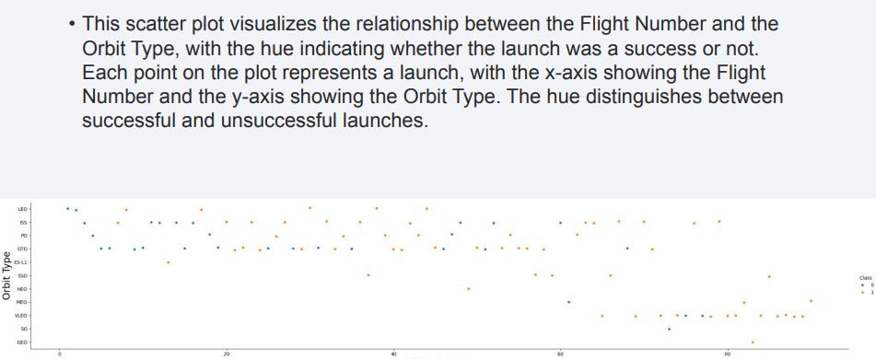
Flight Number vs. Orbit Type

Slide 22
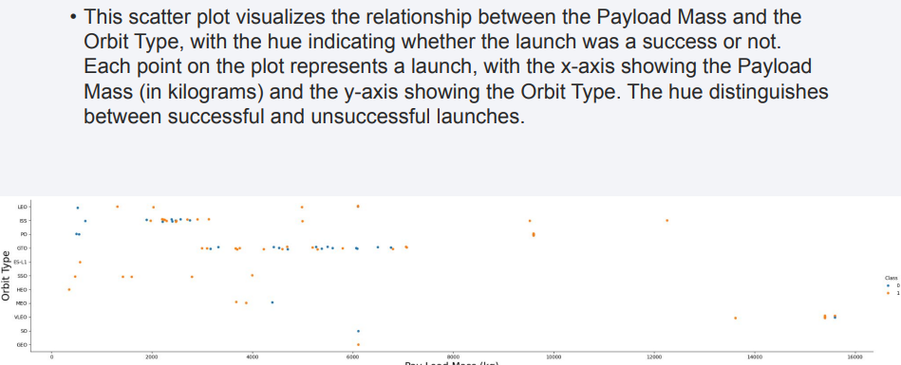
Payload vs. Orbit Type

Slide 23
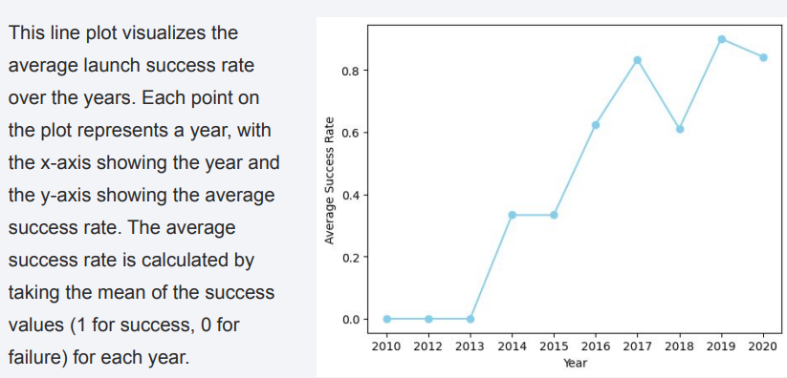
Launch Success Yearly Trend

Slide 24
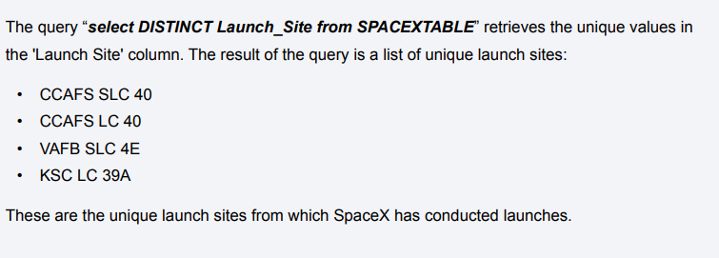
All Launch Site Names

Slide 25
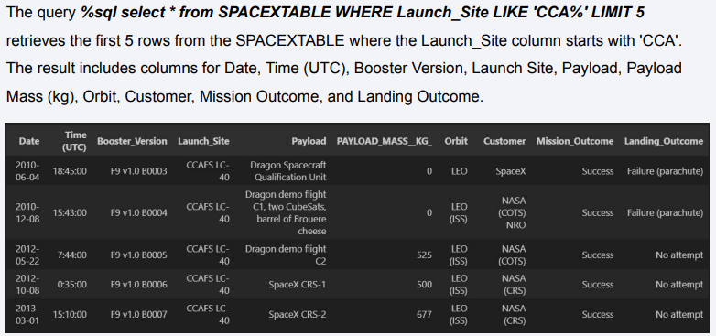
Launch Site Names Begin with 'CCA'

Slide 26
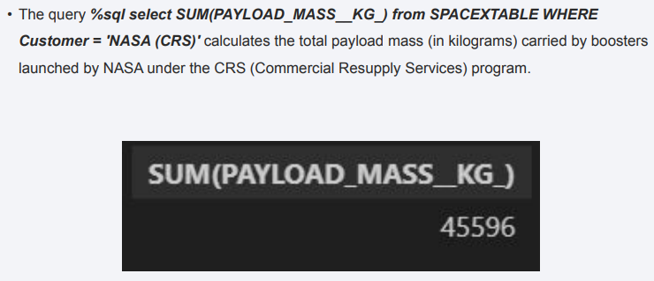
Total Payload Mass

Slide 27
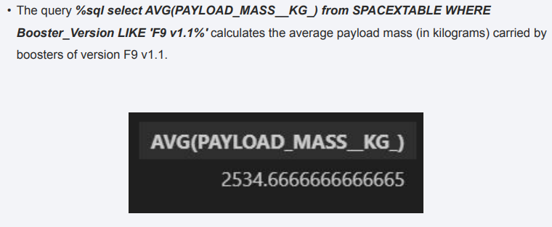
Average Payload Mass by F9 v1.1

Slide 28
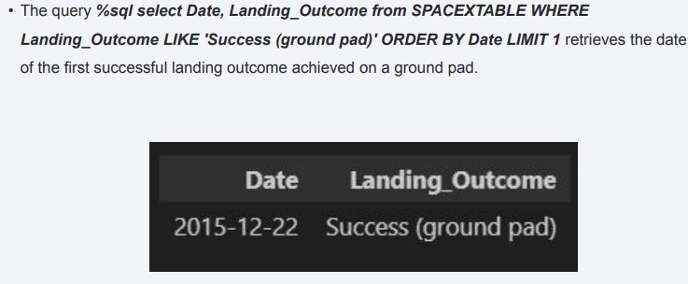
First Successful Ground Landing Date

Slide 29
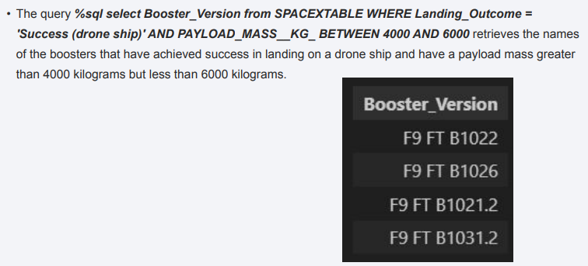
Successful Drone Ship Landing with Payload between 4000 and 6000

Slide 30
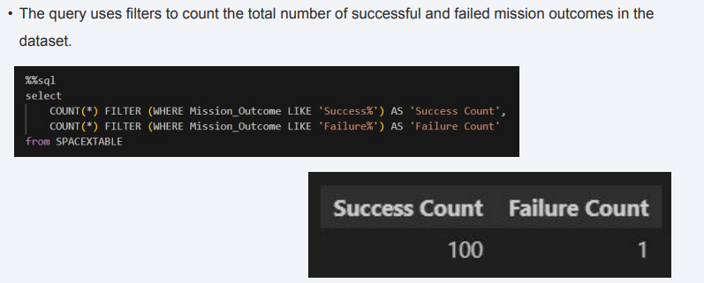
Total Number of Successful and Failure Mission Outcomes

Slide 31
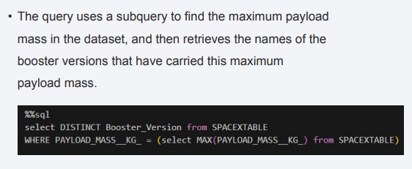
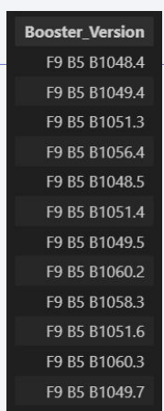
Boosters Carried Maximum Payload

Slide 32
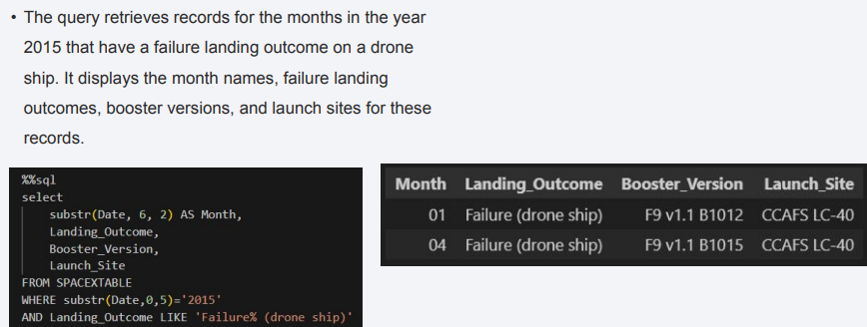
2015 Launch Records

Slide 33
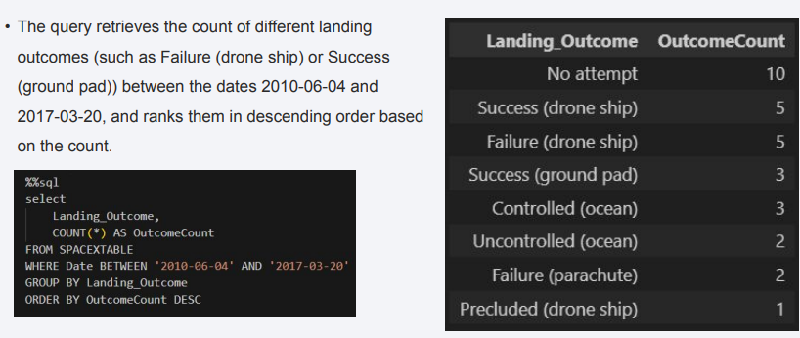
Rank Landing Outcomes Between 2010-06-04 and 2017-03-20

Slide 34

Section 3

Slide 35
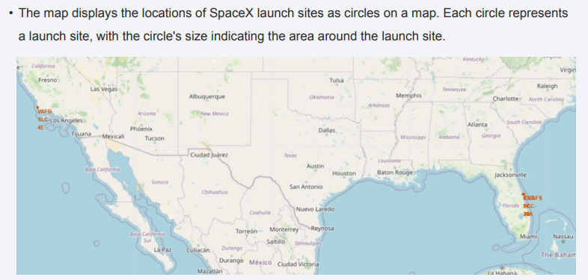
SpaceX Launch Site

Slide 36
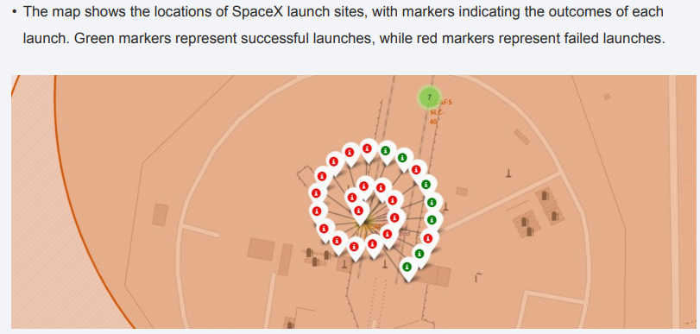
SpaceX Launch Sites with Success Failure Launch Markers

Slide 37
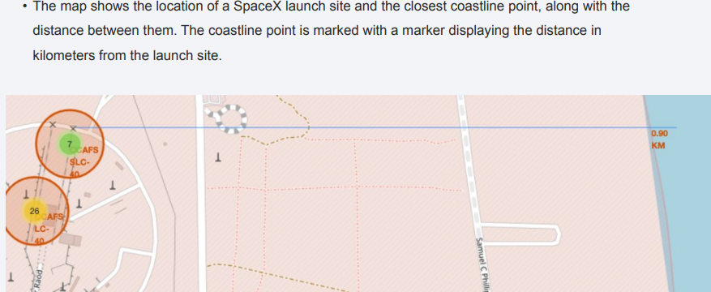
SpaceX Launch Site and Closest Costline with Distance Measurements

Slide 38

Section 4

Slide 39
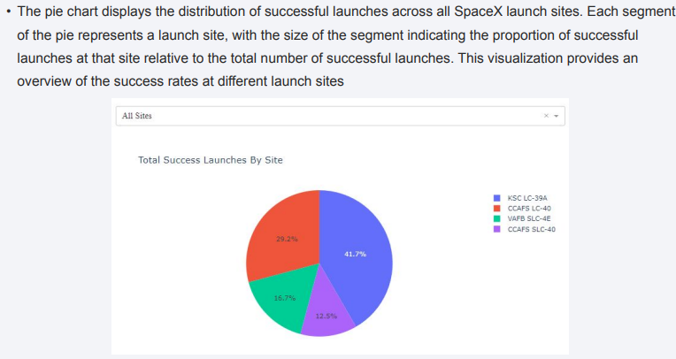
Distribution of Successful Launches Across SpaceX Launch SItes

Slide 40
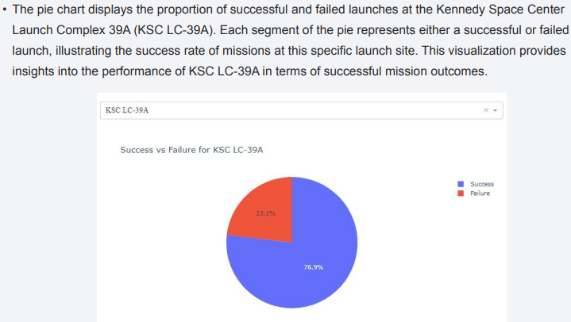
Success vs. Failure Launches at KSC LC-39A

Slide 41
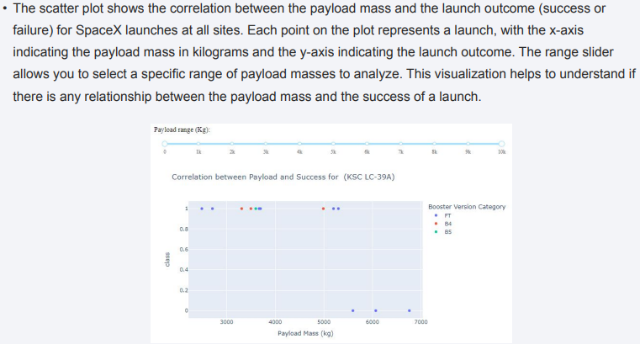
Correlation between Payload Mass and Launch Outcome for SpaceX Lauches

Slide 42

Section 5

Slide 43
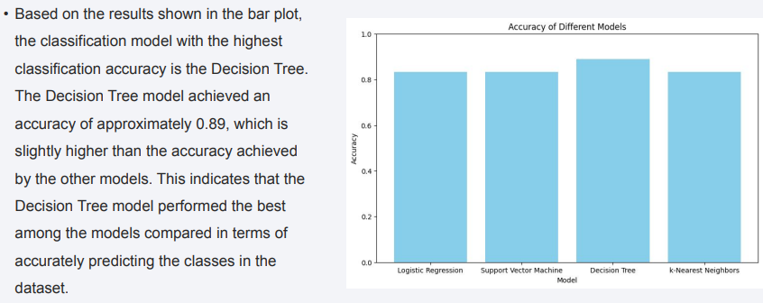
Classification Accuracy

Slide 44
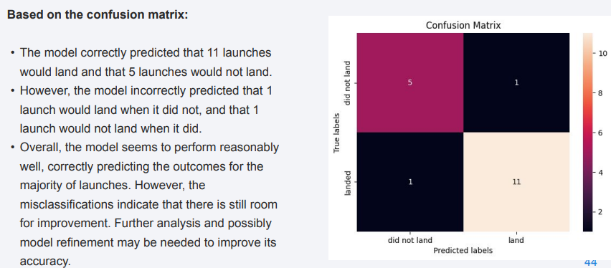
Confusion Matrix

Slide 45
Conclusions
Data Collection and Wrangling: Data was successfully collected from the SpaceX API and underwent through wrangling to address missing values and incorrect data types, ensuring the datasets quality.
Exploratory Data Analysis: EDA revealed interesting insights into SpaceX launch outcomes, including the distribution of successful and failed launches across different launch sites and orbits. Visualizations provided a clear understanding of launch success rates and trends over time.
Predictive Analysis: The project utilized various classification models, including Logistic Regression, SVM, Decision Tree and KNN to predict launch outcomes. These models were evaluated based on their accuracy, with the Decision tree model showing the highest accuracy among them.
Importance of Launch Site: The choice of launch site appears to significantly impact launch success, as evidenced by the analysis of success rates at different sites.
Need for Further Refinement : While the models showed decent accuracy, there is room for further refinement and improvement , particulary in distinguishing between the two classes
Overall insights: The project has provided valuable insights into SpaceX launch outcomes, highlighting the operational efficiency in the aerospace industry.

Slide 46
Appendix
All the code used in this project, including data collection from the SpaceX API, data wrangling, exploratory data analysis, interactive visual analytics and predictive analysis using classification models can be found in the following.
GitHub Repository: https://github.com/mehmetkadri1/IBM-Data-Scientist-Capstone-.git

Slide 47


